Slide 1

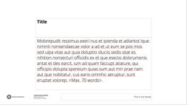




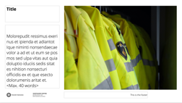


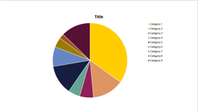




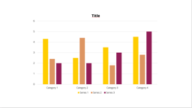

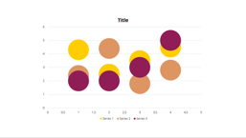
UU POWERPOINT TEMPLATE
OVERVIEW OF TYPE OF SLIDES
DELETE THIS SLIDE
EXCLUDE IT FROM YOUR PRESENTATION
1: Cover
2: Text
3: Full screen image
4: Chapter title/ quote slide
5: Blank
6: Disclaimer
You can add your own image to this slide. This document also includes some ready-made slides.
In three variants
In two variants.
In three variants.
For charts, formulas, etc.
Leave at the end.
To help you get started with charts, we added a few ready-made examples in this document. All you need to do is put in your own data.
Text only
Without caption
Text only
Without partner logos
Text left, image right
With caption
Text left, image right
With partner logos
Text right, image left
Text right, image left

Slide 2
INFOMR Shape Retrieval System
Jarno Hendriksen
Ge Li
October 2024

Slide 3
1
Overview
2
Preprocessing
3
Feature Extraction
4
Querying
5
Scalability
6
Demo

Slide 4
1
Overview
2
Preprocessing
3
Feature Extraction
4
Querying
5
Scalability
6
Demo

Slide 5
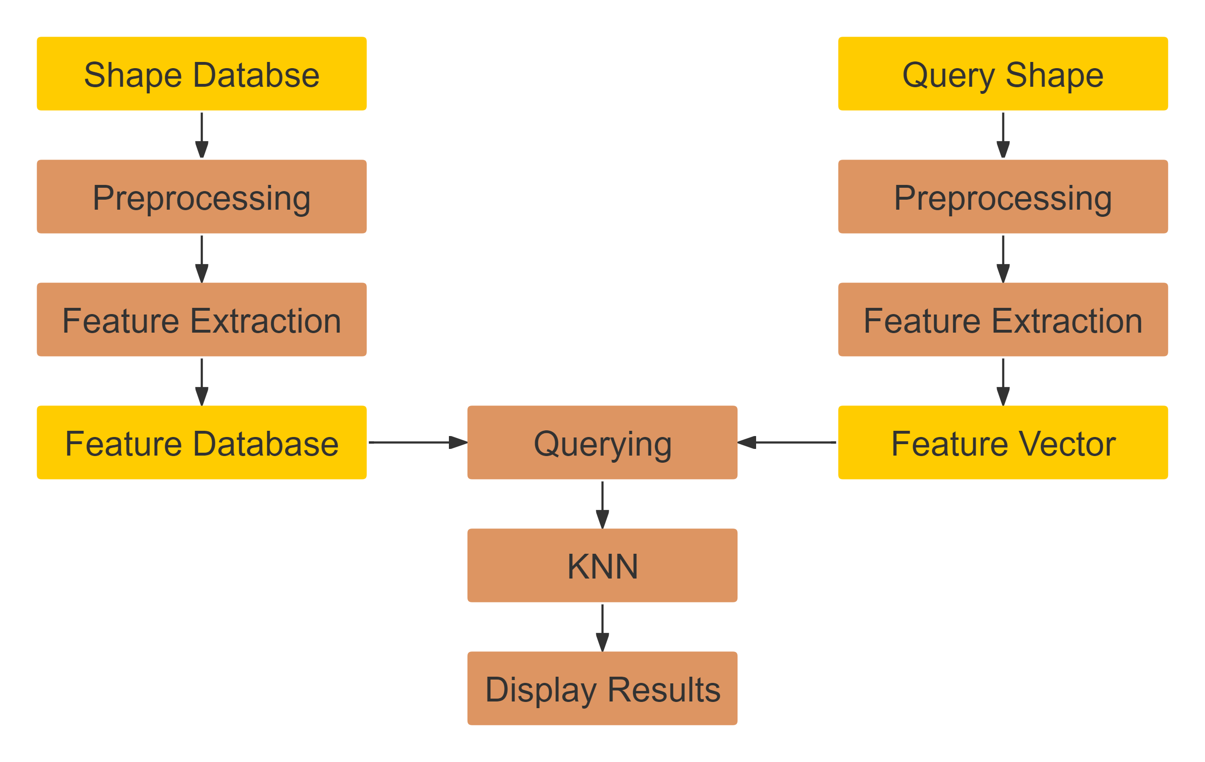
Overview

Slide 6
1
Overview
2
Preprocessing
3
Feature Extraction
4
Querying
5
Scalability
6
Demo

Slide 7
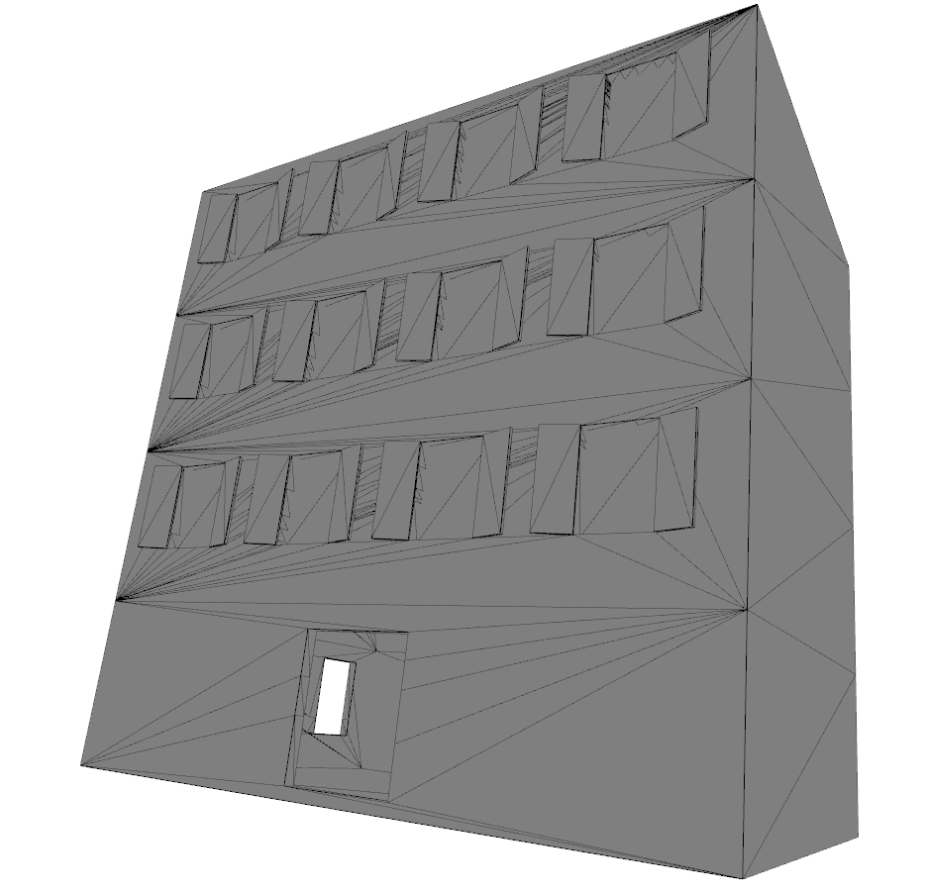
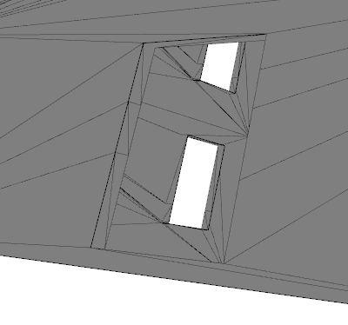
Preprocessing - Mesh fixing
D00792.obj from the class “Apartment”.
Notes:
First, we did a mesh fixing for the models,
because many models were not watertight.
This is an example—it is from the Apartment class.
Both the windows and doors have holes.

Slide 8
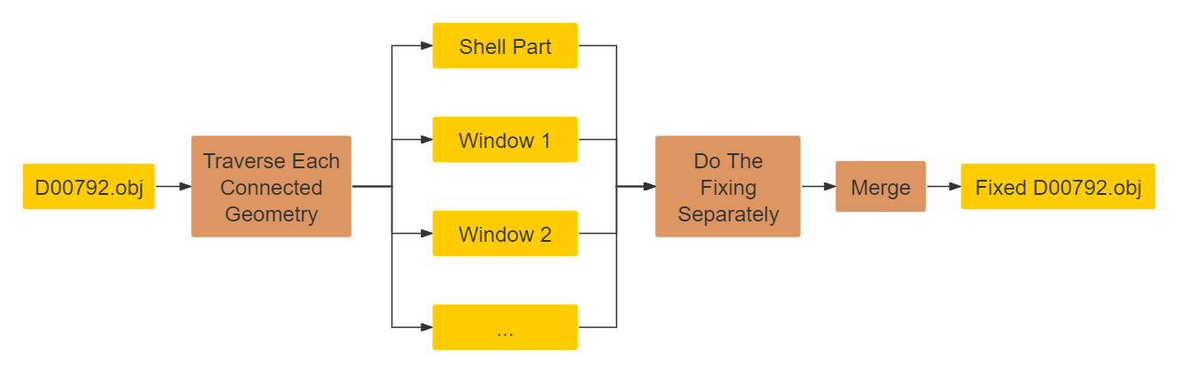
Preprocessing - Mesh fixing
Use “MeshFix” function from the “pymeshfix” package.
Notes:
To solve this, we used the pymeshfix library.
During testing, we found a limitation of this library:
it cannot handle models composed of multiple geometries.
When processing such models, it only retains one of the geometries.
So we traverse each connected geometry and cache them individually.
Then do the fixing separately for each geometry, and finally merged them into a single model file.

Slide 9
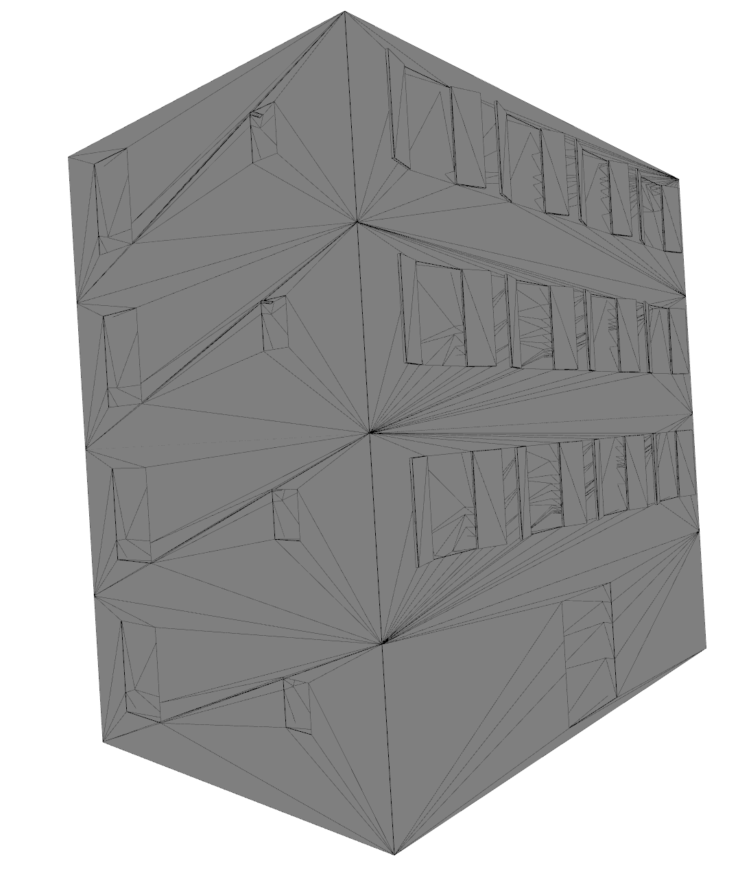
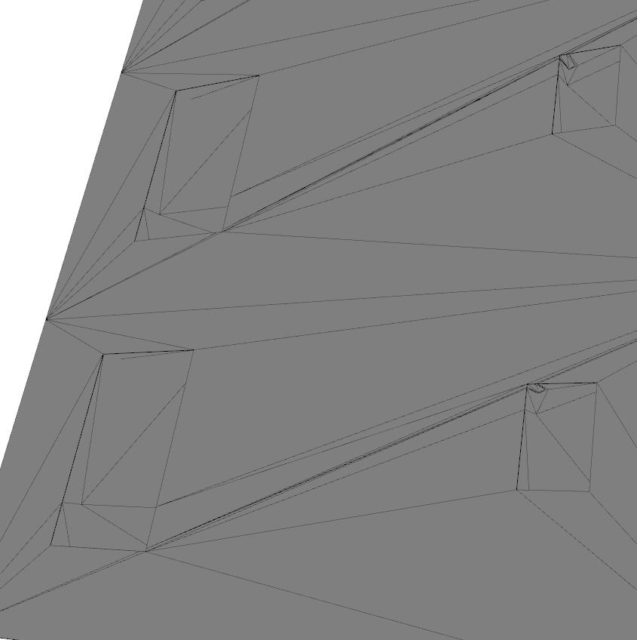
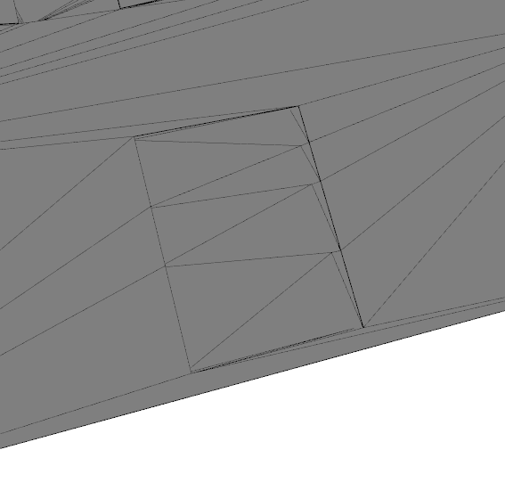
Preprocessing - Mesh fixing
D00792.obj after fixing.
Notes:
This model is consisted of a building shell and several windows.
As you can see, after the fixing , the holes in the shell were fixed
none of the windows were lost.

Slide 10
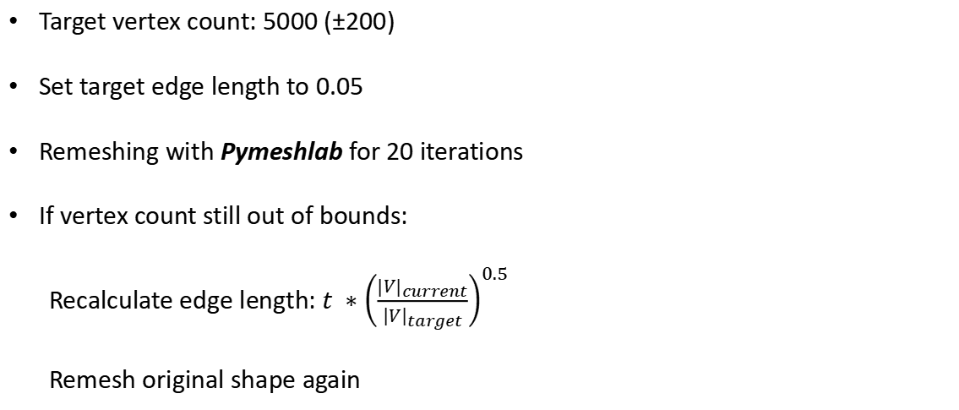
Preprocessing - Resampling
Target vertex count: 5000 (±200)
Set target edge length to 0.05
Remeshing with Pymeshlab for 20 iterations
If vertex count still out of bounds:
Recalculate edge length: $t ∗{\left(\frac{{\left|V\right|}_{current}}{{\left|V\right|}_{target}}\right)}^{0.5}$
Remesh original shape again

Slide 11
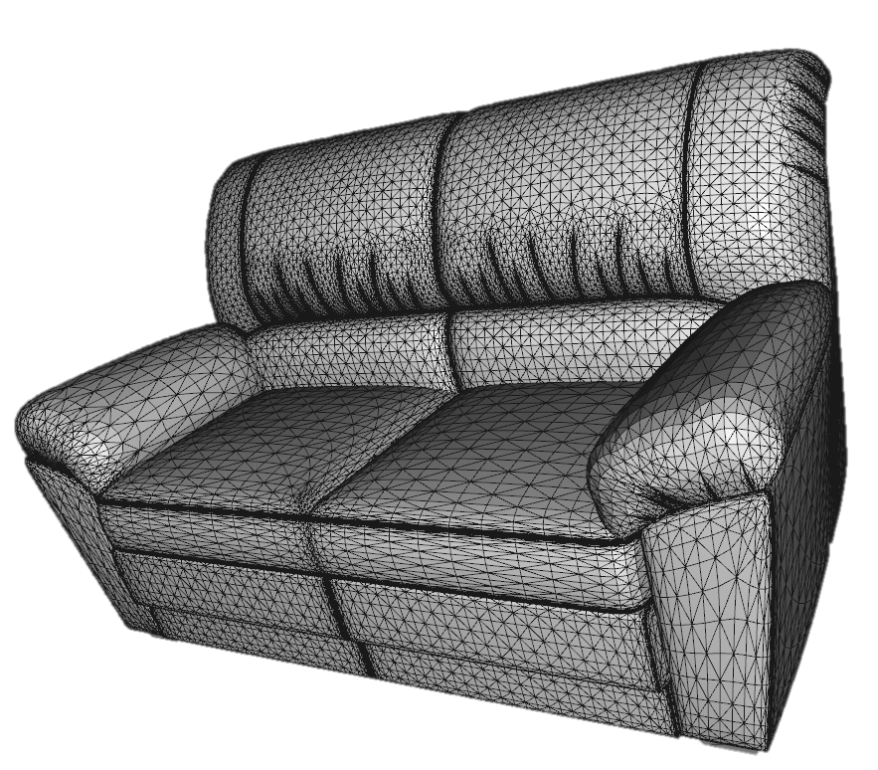
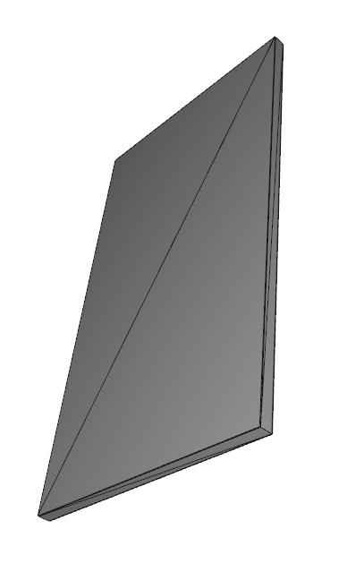
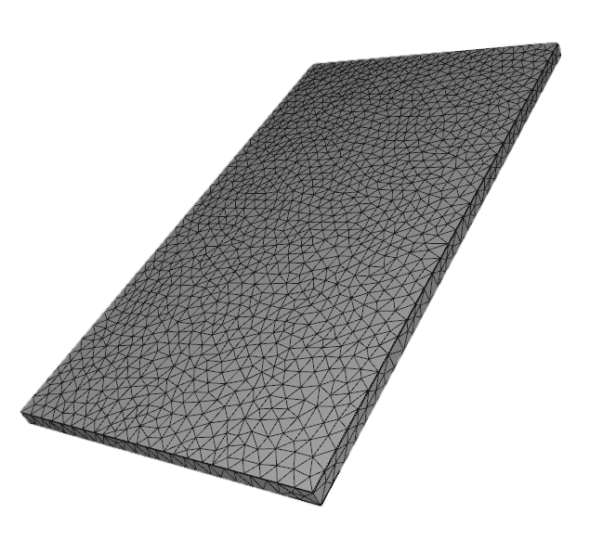
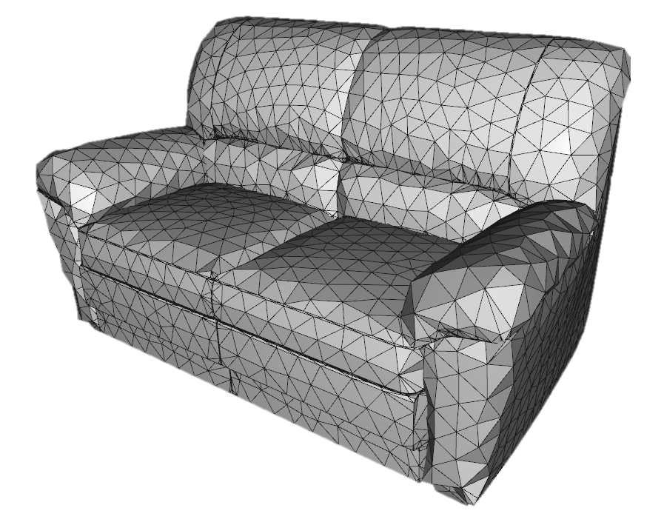
Preprocessing - Resampling

Slide 12
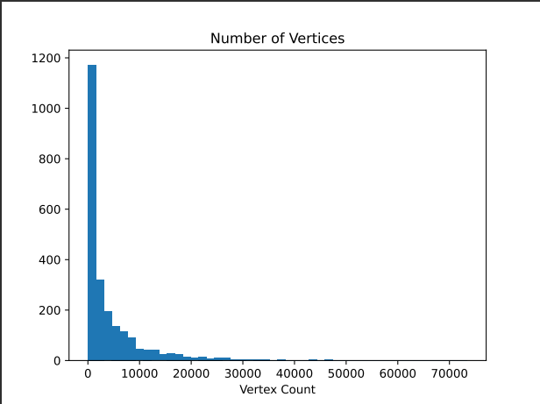
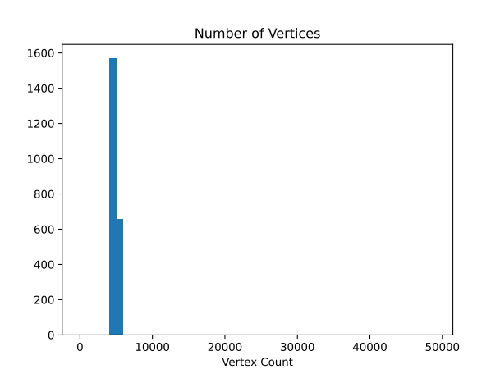
Preprocessing - Resampling

Slide 13
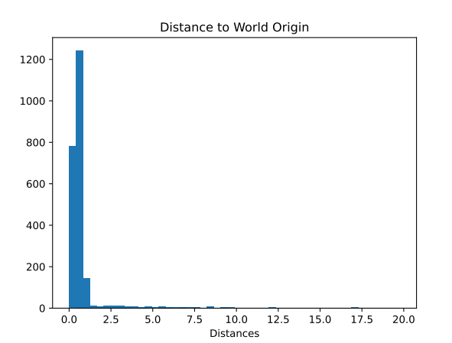
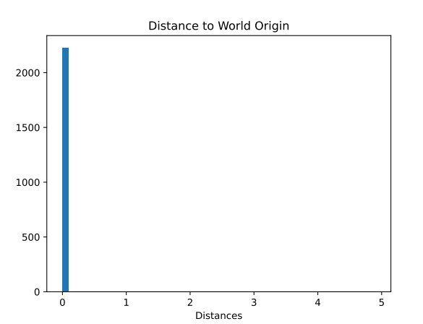
Preprocessing - Normalization - Translation

Slide 14
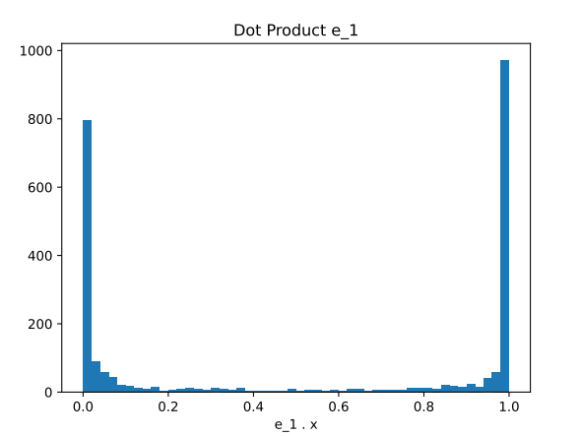
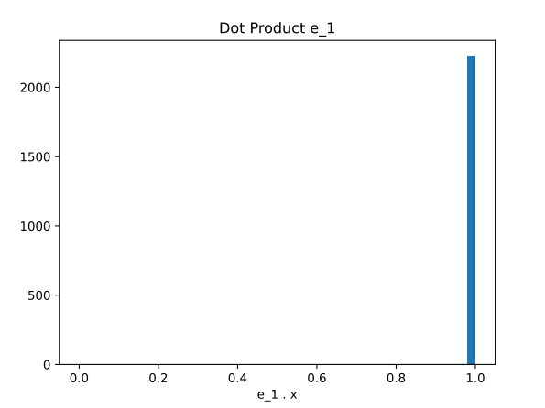
Preprocessing - Normalization - Rotation

Slide 15
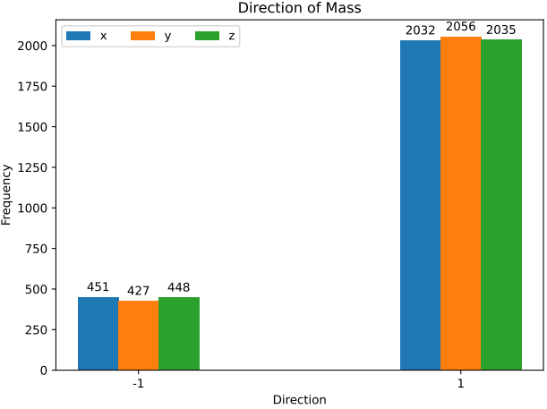
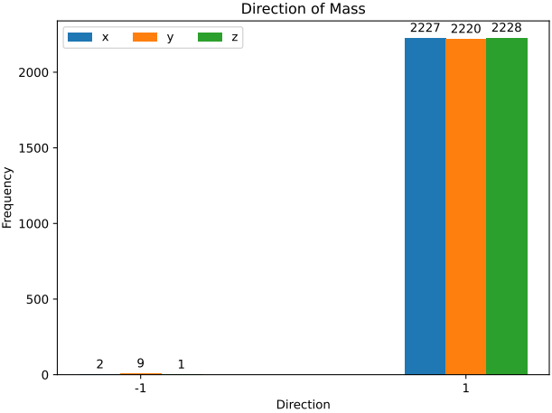
Preprocessing - Normalization - Orientation

Slide 16
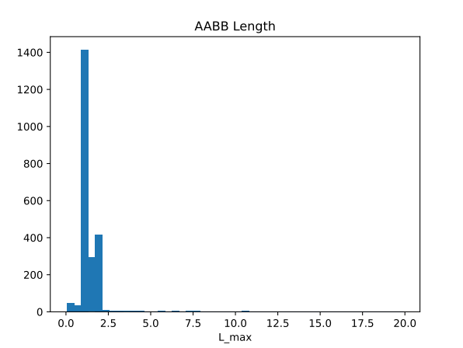
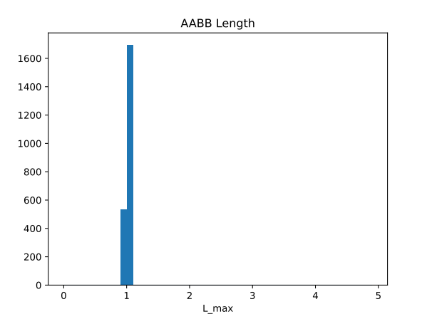
Preprocessing - Normalization - Scaling

Slide 17
1
Overview
2
Preprocessing
3
Feature Extraction
4
Querying
5
Scalability
6
Demo

Slide 18
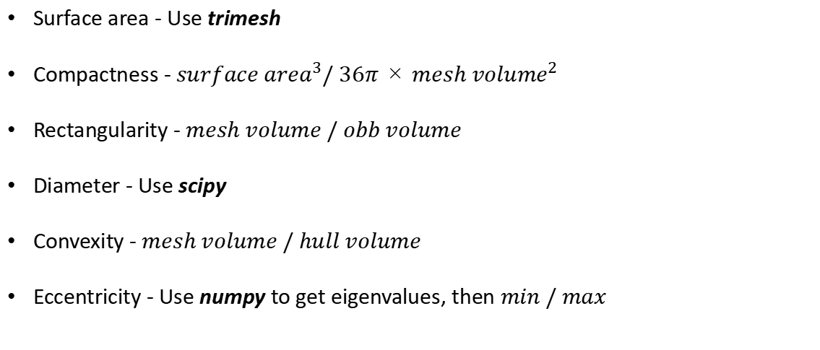
Feature Extraction - 3D Property Descriptors
Surface area - Use trimesh
Compactness - ${surface area}^{3}/ 36π × {mesh volume}^{2}$
Rectangularity - $mesh volume / obb volume$
Diameter - Use scipy
Convexity - $mesh volume / hull volume$
Eccentricity - Use numpy to get eigenvalues, then $min / max$
Notes:
After preprocessing the database, we needed to extract features from the models.
3D property descriptors is combined with these single values
Some of these features could be directly obtained by calling functions from the library, like surface area and diameter.
Others required simple calculations.

Slide 19
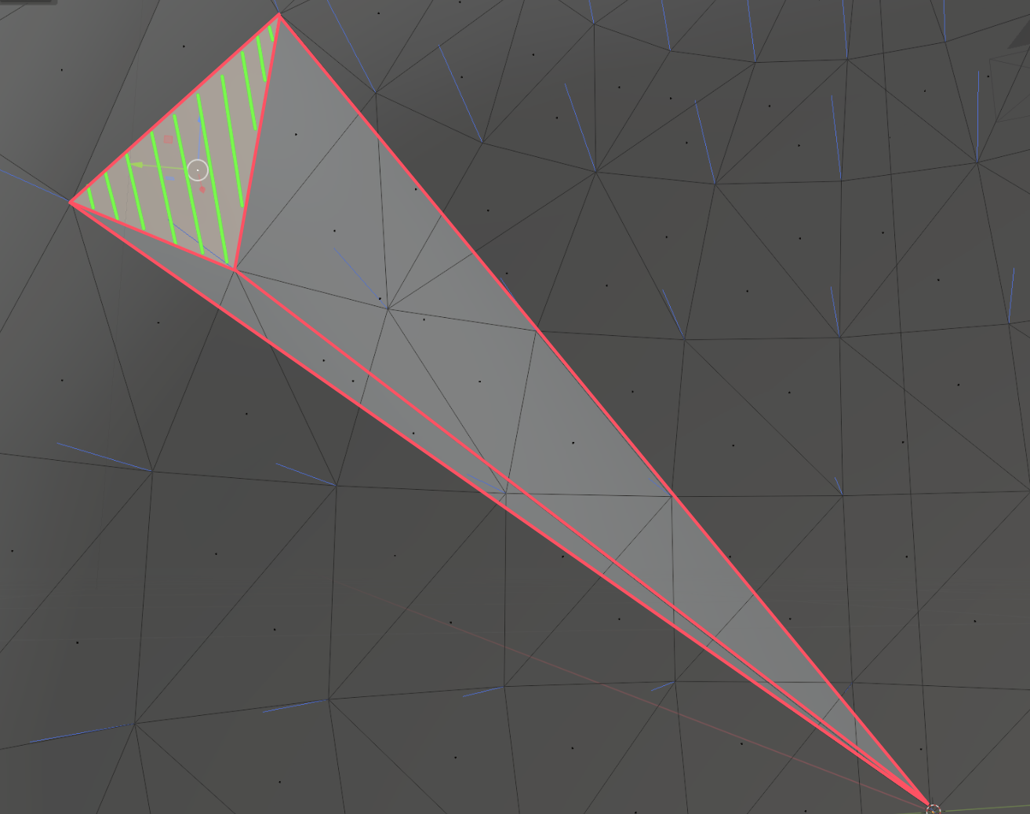
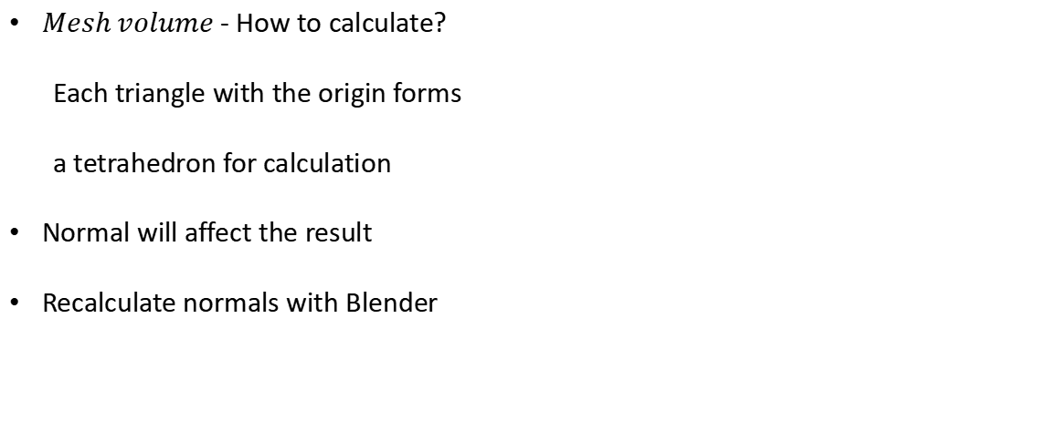
Feature Extraction - 3D Property Descriptors
$Mesh volume$ - How to calculate?
Each triangle with the origin forms
a tetrahedron for calculation
Normal will affect the result
Recalculate normals with Blender
Origin
Notes:
I would like to specifically mention the calculation of volume.
The green triangle is a part of the model.
It along with the origin point, where the white arrow points to.
They form a tetrahedron. It is high lighted in green.
The calculation is signed, the sign is determined by the direction of the normal, means the blue line in the figure
By summing the volumes of these tetrahedrons, we can get the whole volume of the mesh.
The normal direction of each triangle affects the result.
Some models in the library had incorrect normals
And during the normalization, we can’t ensure the normals remained correct after transforming the vertices.
So we use Blender to perform a simple fix for these normals.

Slide 20
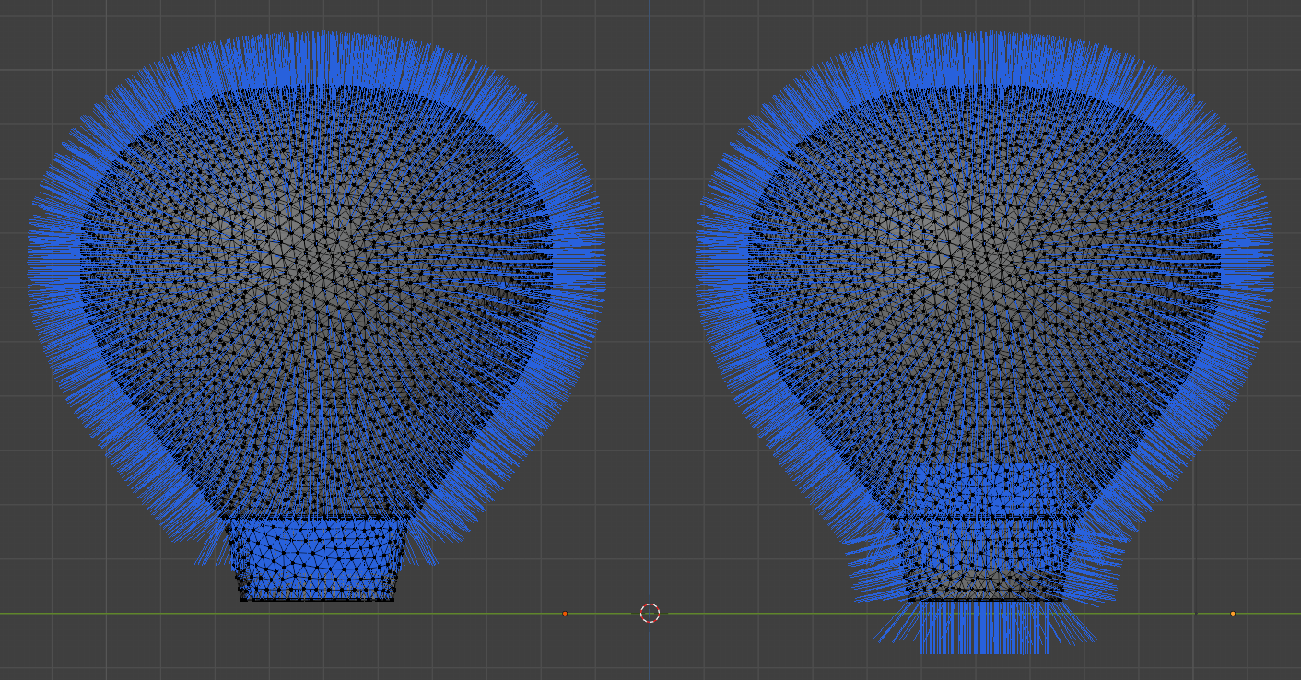
Feature Extraction - 3D Property Descriptors
Notes:
Blender itself provides a Python interface
And it is a professional 3D software, allows for accurate normal calculate
We used scripts to batch process the models in our database.
Here is a comparison before and after the repair.
The blue lines are the vertex normals of the model.

Slide 21
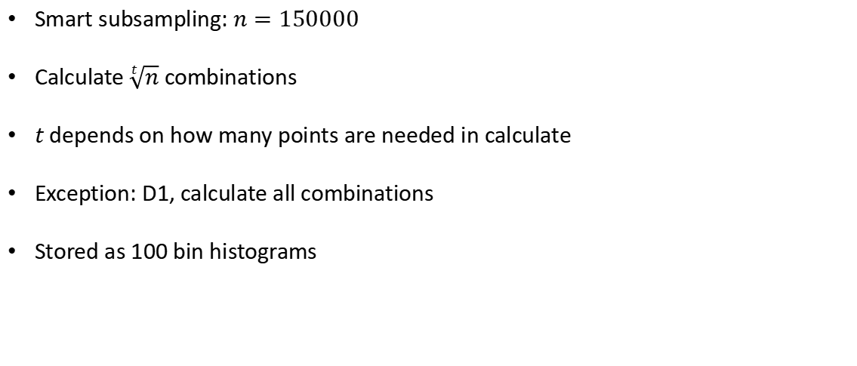
Feature Extraction - Shape Property Descriptors
Smart subsampling: $n=150000$
Calculate $\sqrt[t]{n}$ combinations
$t$ depends on how many points are needed in calculate
Exception: D1, calculate all combinations
Stored as 100 bin histograms
Notes:
For the Shape Property Descriptors, we applied smart subsampling
Let n set to 150,000.
The final number of combinations depends on the value of t
t indicates the number of vertices required.
For example, calculating A3 requires three vertices, so t is set to 3.
D1 is an exception. It is the distance from each vertex to the origin
we can directly calculate the distance for all vertices.
The result of each descriptor is stored as 100 bin histograms

Slide 22
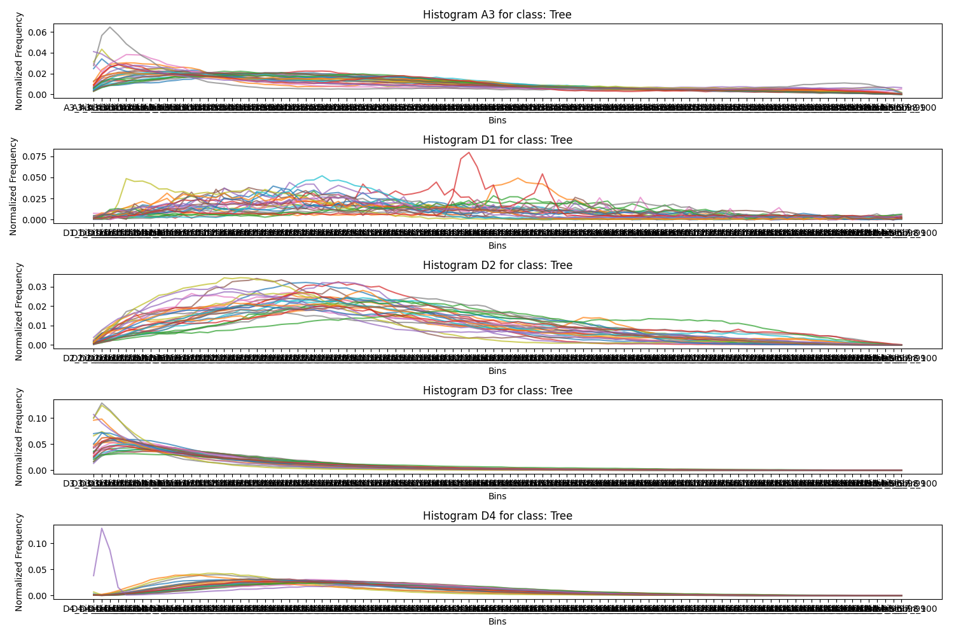
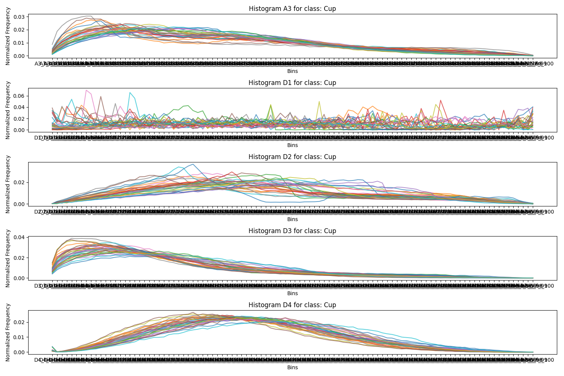
Feature Extraction - Process Descriptors
Single value descriptors: normalize by standardization for each type
Histogram descriptors: normalize the histogram
Store as a CSV file
Notes:
The extracted features need a final process
Single-value features are standardized within each type
And histograms are normalized.
Finally, all features are stored in a CSV file.
The figure shows the D4 for the Cup and Tree class.
Histograms within the same class are quite similar
and between the two classes is really different
it appears the Tree class has an outlier however

Slide 23
1
Overview
2
Preprocessing
3
Feature Extraction
4
Querying
5
Scalability
6
Demo

Slide 24
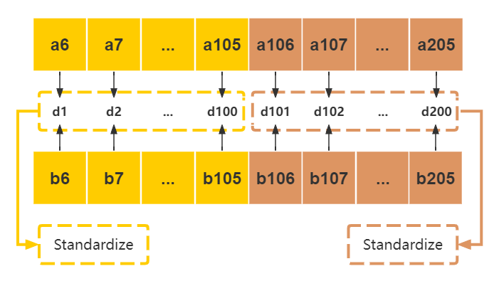
Querying - Distance Weighting
Calculate the Euclidean distance
Divide each histogram distance value into a set
Perform distance standardization for each set
Sum the resulting final values
Notes:
The query is by calculating the distance of feature between two models.
the yellow and brown represent two different feature histograms.
We calculate the Euclidean distance between models
We divide each histogram distance value into a set
Then perform distance standardization to each set.
And sum the result values.
We do this to reduce the imbalance between single-value features distances and histogram distances.

Slide 25
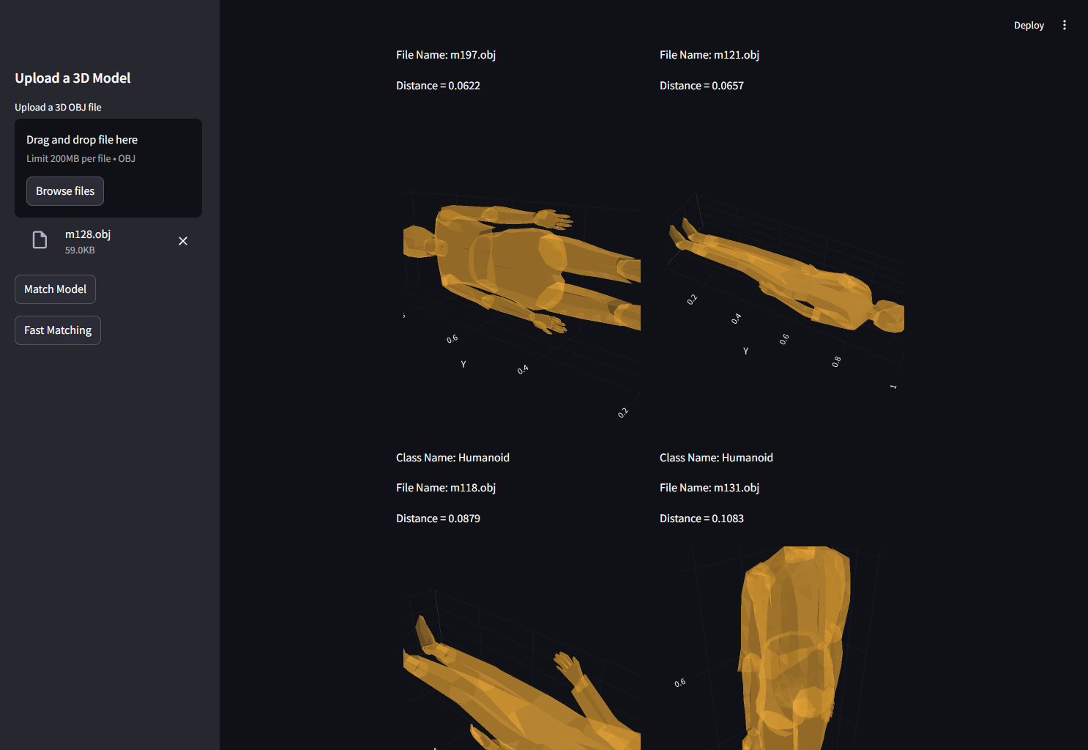
Querying - Interface
Use streamlit
Will show the top 4 similar models
Notes:
We use streamlit for the user interface
It will be shown in the video.

Slide 26
1
Overview
2
Preprocessing
3
Feature Extraction
4
Querying
5
Scalability
6
Demo

Slide 27
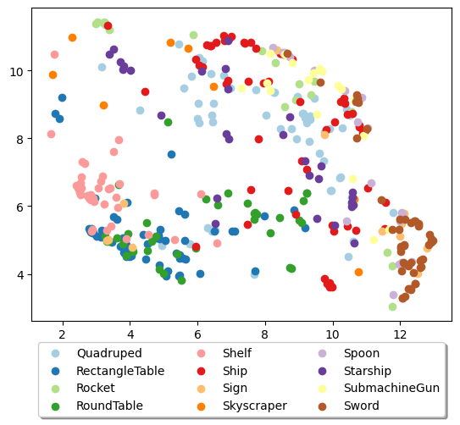
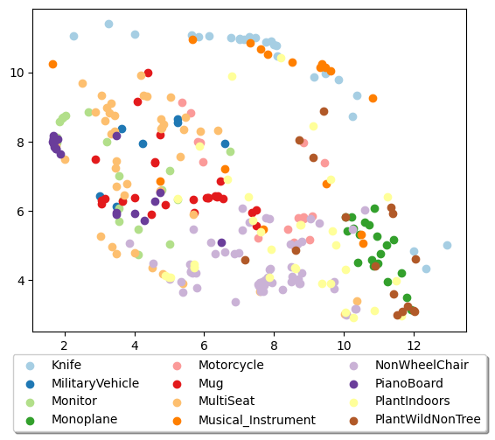
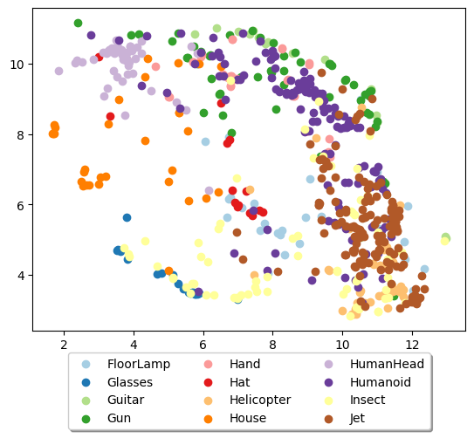
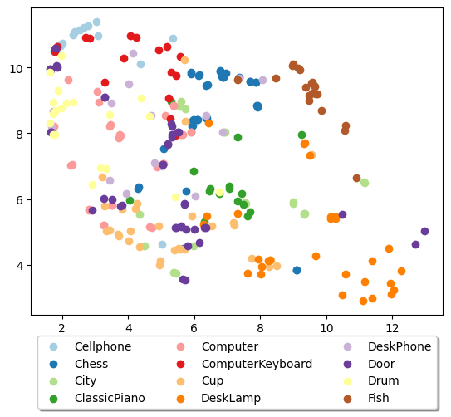
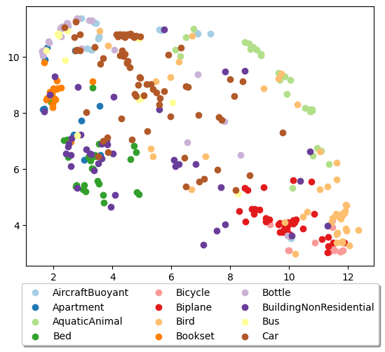
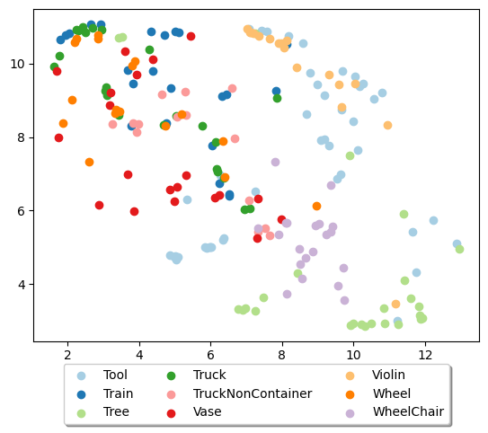
Scalability
1500 iterations
35 perplexity

Slide 28
1
Overview
2
Preprocessing
3
Feature Extraction
4
Querying
5
Scalability
6
Demo

